Slide 1
To Establish Baseline for Threat Detection
Name: Goyal Taruchit Tarun Chitra
BITS ID: 2022DC04496
Course: WILP M Tech Data Science and Engineering
Supervisor: Ms. Prathibha Rao
Evaluator: Prof. S. Geetha
Institute: Birla Institute of Technology and Science Pilani
Month and year: March 2025

Slide 2
Goals of the project
To build binary class and multi-class classifiers to detect and differentiate between malicious and benign events in a network.
To use heuristic algorithms for feature selection to optimally train the classifiers.
To build benchmark on quality of results that can be achieved without usage of advance methods like Deep learning and Graph Neural Networks
Robust evaluation of models and understand the reasons for the outcomes observed

Slide 3
Summary of literature survey
Most researchers rely on advance techniques to train models.
Some of the heuristic algorithms were used for optimal feature selection: -
Ant Colony optimization
Particle Swarm optimization
Artificial Bee Colony optimization
Accuracy was a commonly used metric used to evaluate results of feature selection.
Evaluation of models were carried out on 3 or 4 metrics: -
Accuracy
Precision
Recall
F1-Score

Slide 4
Gaps observed in literature survey
Handling imbalanced datasets is an essential problem while dealing with real-world use cases, only using accuracy does not help to address the same.
Usage of few metrics for evaluation does not help to get overall quality of the classifiers.
Size of datasets used are very small: -
Number of records range between 50 to 3000.
Number of independent features range between 4 to 25.
Usage of Machine Learning algorithms is compute intensive.
Number of iterations range between 100 to 1000 thus, compute intensive approach.
Lack of emphasis to fetch smaller subset of optimal features.

Slide 5
Cybersecurity use cases in the industry
Some of the industry use cases for cybersecurity: -
Classification of email as spam and not-spam, phishing and not-phishing.
Summarization of Indicators of Compromise (IOCs) for intrusion detection system.
Real time monitoring and alerting when events generate spikes greater than threshold are observed.
UEBA for anomaly detection.

Slide 6
Analysis and selection of datasets
Seven opensource cybersecurity datasets were fetched and analysed based on following parameters: -
Number of records
Number of features
Number of duplicates
Number of null records
Based on above parameters, CIC dataset was selected.
Properties of the dataset: -
Naturally captured, overcomes drawbacks of synthetic datasets.
No null records
Very large volume of data: 9167581 records and 57 independent features

Slide 7
Data pre-processing
Removal of duplicates.
Handling outliers using two methods: -
Winsorization
Imputation with median
Handling negative values by imputing them with median
Removing features with only one unique value.

Slide 8
Exploratory Data Analysis

Slide 9
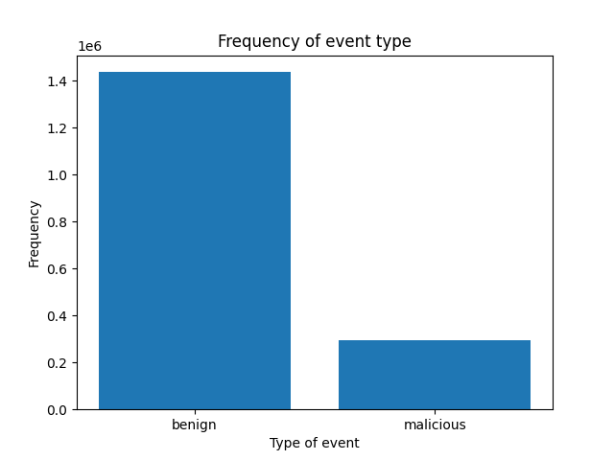
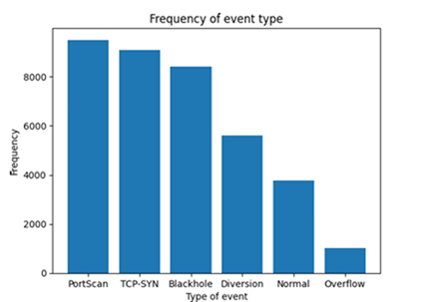
Class imbalance in the dataset
Visualization of class imbalance in the dataset using Bar chart.
Figure 1: Visualizing class imbalance for binary class classification Figure 2: Visualizing class imbalance for multi class classification

Slide 10
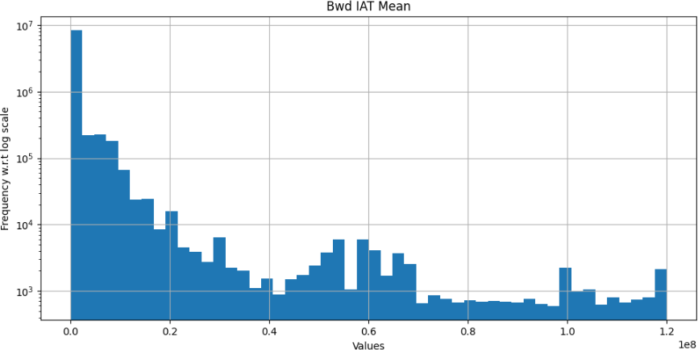
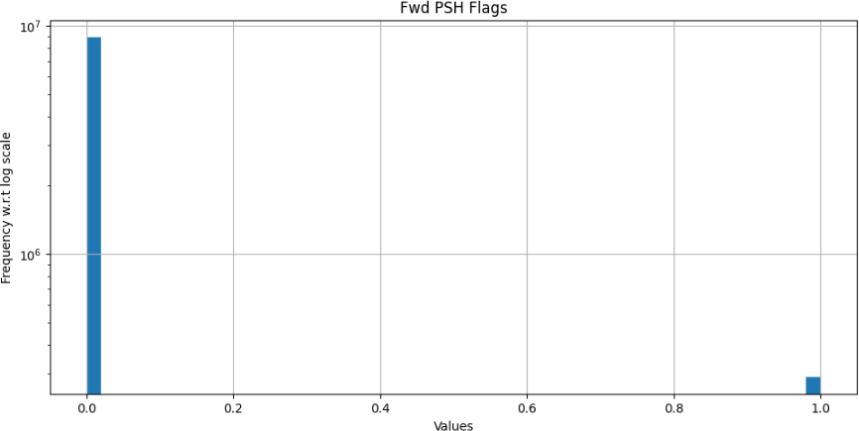
Visualizing and interpreting distribution of each feature
Figure 3: Histogram to visualization distribution of Bwd IAT Mean
Figure 4: Histogram to visualization distribution of Fwd PSH Flags

Slide 11
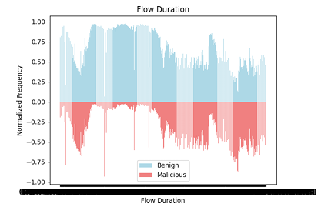
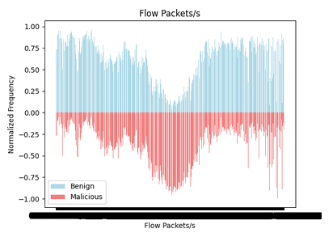
Pyramid chart for binary classification of each feature
Figure 5: Pyramid chart for Flow Duration w.r.t isMalicious
Figure 6: Pyramid chart for Flow Packets/s w.r.t isMalicious

Slide 12
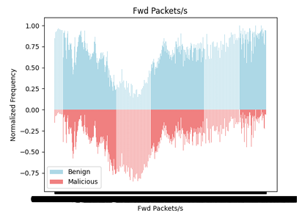
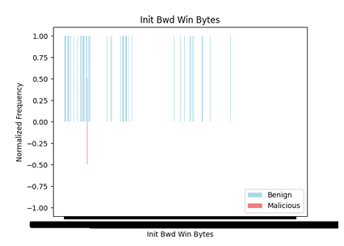
Pyramid chart for binary classification of each feature
Figure 7: Pyramid chart for Fwd Packets/s w.r.t isMalicious
Figure 8: Pyramid chart for Init Bwd Win Bytes w.r.t isMalicious

Slide 13
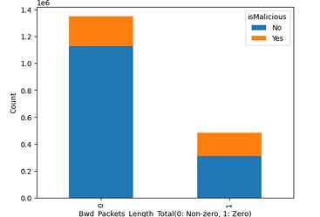
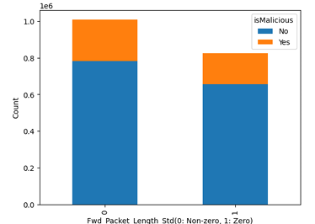
Visualization based on descriptive statistics
Figure 9: Stacked bar chart for comparison of isMalicious for zero and non-zero values of Bwd Packets Length Total
Figure 10: Stacked bar chart for comparison of isMalicious for zero and non-zero values of Fwd Packet Length Std

Slide 14
Flowchart to build test dataset

Slide 15
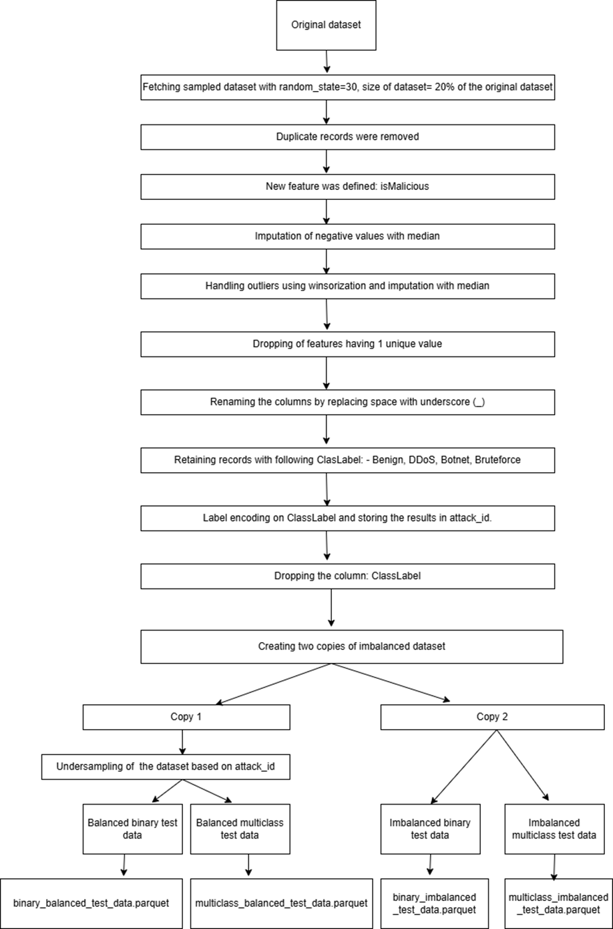

Slide 16
Heuristic algorithms
There are over 40 nature inspired heuristic algorithms.
3 Es of heuristic algorithms: -
Exploration
Exploitation
Evolution
Following two algorithms were studied and implemented for feature selection: -
Artificial Bee Colony optimization
Flower Pollination Algorithm

Slide 17
Artificial Bee Colony optimization
3 major phases: -
Employed bee phase
Onlooker bee phase
Scout bee phase
Uses a different objective function and fitness function, unlike other heuristic algorithms.
Perform Greedy search for comparing current solution with partner solution and select the best among them
It searches for partner solution in neighbourhood of current solution.

Slide 18
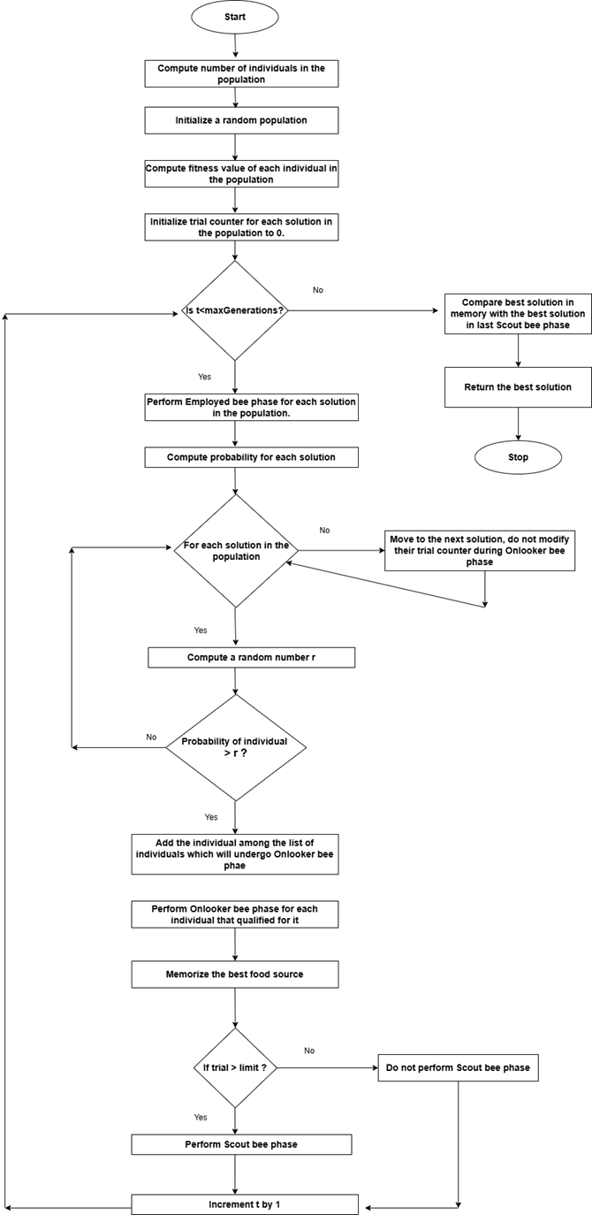

Slide 19
Flower Pollination Algorithm
2 major phases: -
Global pollination
Local pollination
In Global pollination, it searches for new solutions using Levy distribution.
In Local pollination, it searches for new solutions using Normal distribution.
Switch probability helps to determine which phase gets executed in each iteration.

Slide 20
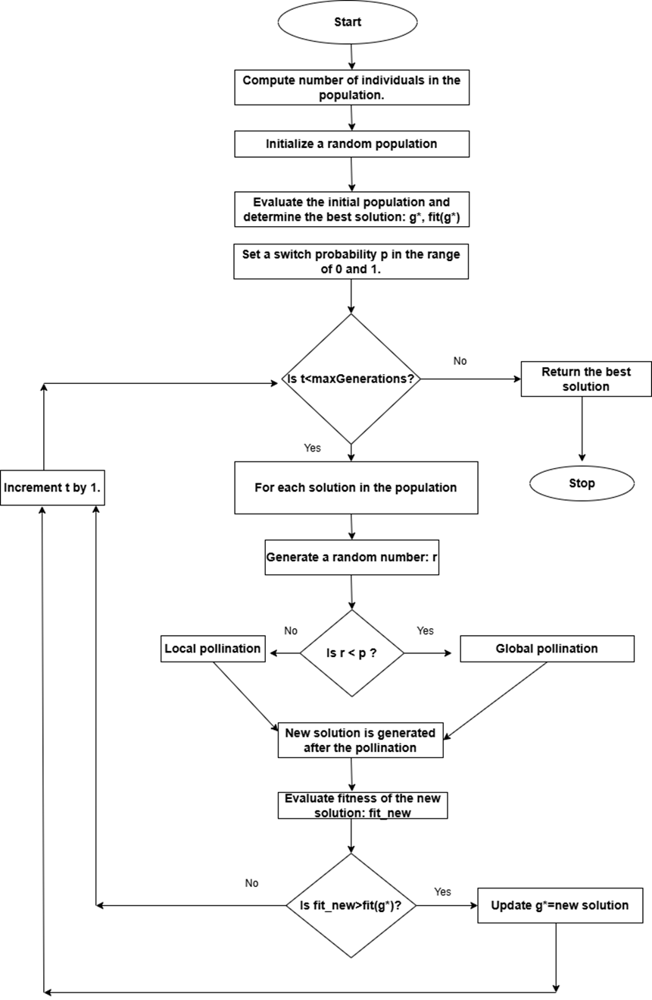

Slide 21
Machine Learning algorithm
Following are some of the ML algorithms used for training classifier models: -
Logistic Regression
Support Vector Machine
Decision Trees
Random Forest
Naïve Bayes
K Nearest Neighbour
K Nearest Neighbour (KNN) was used in the project.
Reason for selecting KNN: -
Lazy learner: Computationally lesser intensive during the training phase.
Used for both binary and multi-class classification
Commonly used in fraud detection and medical diagnosis.

Slide 22
Evaluation metrics
Following evaluation metrics were used for robust evaluation of classifiers: -
Confusion matrix
Accuracy
Precision
Recall
F1-Score
ROC curve
AUC score
Balanced accuracy
Matthews Correlation Coefficient (MCC)
Negative Predictive Value (NPV)
False Discovery Rate (FDR)
Cohen Kappa metric
Precision – Recall curve

Slide 23
Scaling of independent features
Two independent scaling approaches were used: -
Standard Scaler
Robust Scaler
Standard Scaler: -
z = (x - µ) / s
Where: - x is the data point
µ is the mean value.
s is the standard deviation
Robust Scaler: -
It removes median and scales data with respect to IQR.
Helps to deal with outliers.

Slide 24
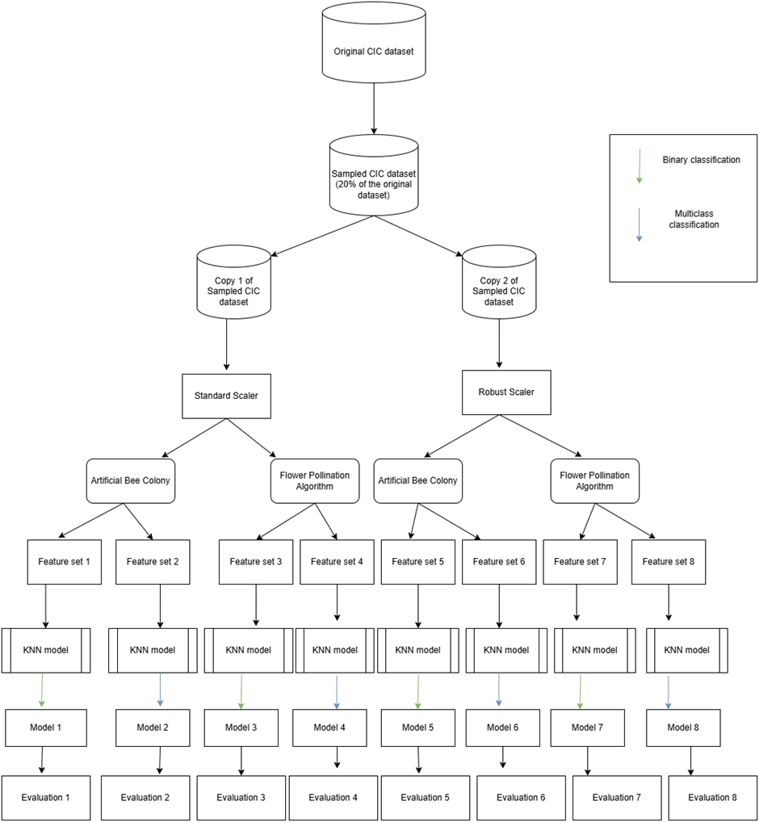

Slide 25
Defining objective function for feature selection
Feature selection has two conflicting objectives: -
Having high performance by maximizing the number of correct classifications.
Having smaller subset of optimal features to reduce model complexity.
Moreover, in cybersecurity use case, correct classification of malicious events is more important than correct classification of benign events.
Thus, the objective function was defined using “Recall” and “Penalty” and taking their difference.
Recall = Focuses on maximizing correct classification of malicious events (which are lesser in number due to imbalance nature of data) and reducing incorrect classification of malicious events as benign.
Penalty = It takes product of two ratios: -
Number of features in the current subset/Total number of features
Current iteration/Total number of iterations
And multiples the product by 2.

Slide 26
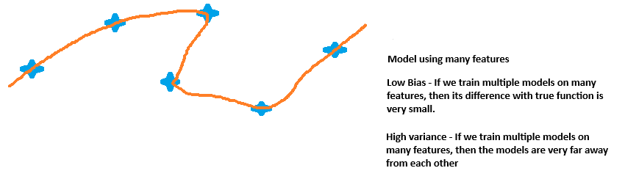
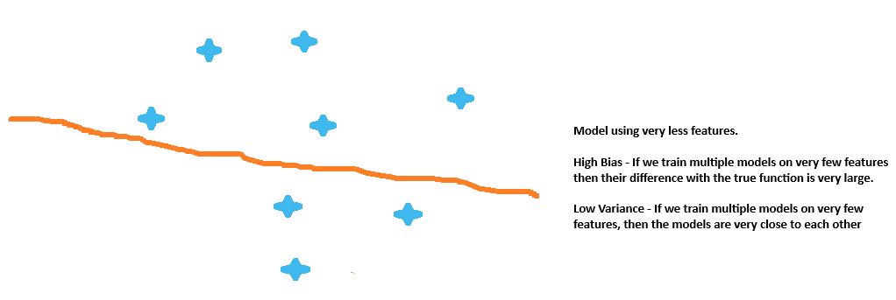
Reason to emphasis on optimal number of features
Overfitting
Underfitting

Slide 27
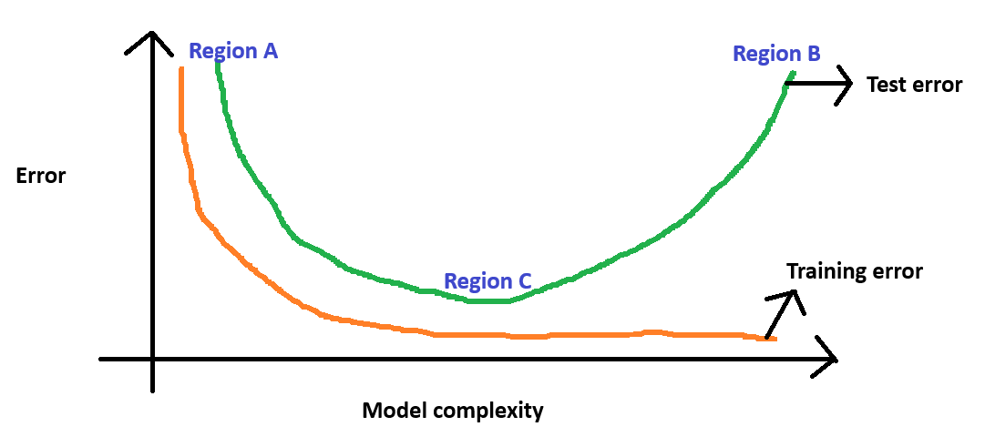
Model complexity vs Error

Slide 28
Example to illustrate computation of objective value
Total number of independent features after pre-processing = 45
Current subset of features = 10
For generation 1: - penalty = (10/45) * (1/5) * 2 = 0.088
For generation 2: - penalty = (10/45) * (2/5) * 2 = 0.178
For generation 3: - penalty = (10/45) * (3/5) * 2 = 0.267
For generation 4: - penalty = (10/45) * (4/5) * 2 = 0.356
For generation 5: - penalty = (10/45) * (5/5) * 2 = 0.444
Thus, for same subset of features the penalty value gets increased as we progressed further in generation.

Slide 29
Illustration to explain impact of penalty on overall computation
Let us consider the below scenario observed at the end of 5th generation: -
1. Subset 1: 35 features, Recall = 0.98
Penalty = (35/45) * (5/5) * 2 = 1.56
Updated value of objective function = 0.98 – 1.56 = -0.59
2. Subset 2: 15 features, Recall = 0.90
Penalty = (15/45) * (5/5) * 2 = 0.67
Updated value of objective function = 0.90 – 0.67 = 0.23

Slide 30
Configurations during feature selection and model training
KNN: - Default value of k=5 was chosen.
Number of generations (iterations) = 5
Objective function = Recall - Penalty
Number of subset of features evaluated in each iteration of feature selection = 22

Slide 31
Evaluation of classifiers

Slide 32
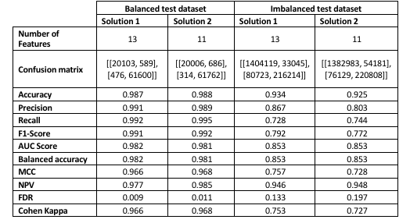
Evaluation results for Binary classification

Slide 33
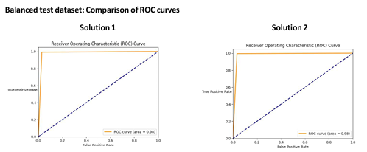
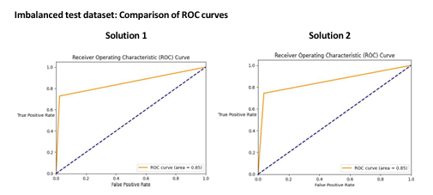
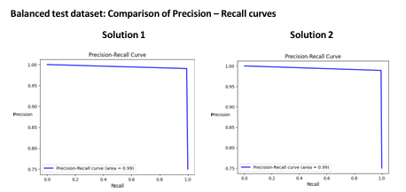
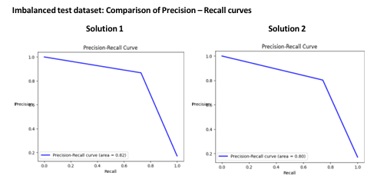
Evaluation results for Binary classification

Slide 34
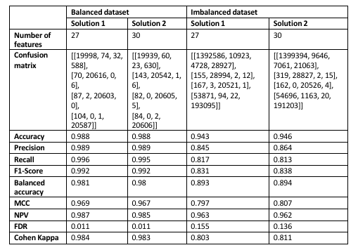
Evaluation results for Multi-class classification

Slide 35
Comparison of results between ABC and FPA after 5 generations for Binary classifier
Metrics | ABC | FPA
Accuracy range | 0.925 - 0.934 | 0.939 - 0.944
Precision range | 0.803 - 0.867 | 0.863 - 0.866
Recall range | 0.728 - 0.744 | 0.767 - 0.795
F1-Score range | 0.772 - 0.792 | 0.812 - 0.829
AUC Score range | 0.853 | 0.871 - 0.885
MCC range | 0.728 - 0.757 | 0.778 - 0.797
NPV range | 0.946 - 0.948 | 0.953 - 0.958
FDR range | 0.133 - 0.197 | 0.134 - 0.137
Cohen Kappa range | 0.727 - 0.753 | 0.776 - 0.796

Slide 36
Summary of evaluation
Flower Pollination Algorithm > Artificial Bee Colony optimization
Standard Scaler > Robust Scaler
Balanced test datasets > Imbalanced test datasets
Overlapping results were observed when compared with models in literature survey.

Slide 37
Conclusions
By performing Mathematical analysis, Heuristic algorithms can help to achieve high performance classifiers by fetching optimal subset of features.
Choice of scaling approach plays an important role in outcome of feature selection and performance of models.
Experimentation and understanding of different parameters is important to understand obtain global optimal results.
Evaluation of models with diverse metrics and comparing them is essential for robust evaluation of their performance.
Trade-off between number of features used to train the model and performance of the model is essential to address for achieving desired results.
Experiments and research on imbalanced, large and real-time datasets is essential to build models which can help in real-world cyber security applications.

Slide 38
Future scope
Use of alternate objective functions for feature selection and compare the outcomes. For example: -
MCC - Penalty
AUC score - Penalty
Cohen Kappa - Penalty
Alternate heuristic algorithms for feature selection.
Use of alternate Machine Learning algorithms.
Parameter tuning of Machine Learning algorithms.
Parameter tuning of Heuristic algorithms.
Compare how results change with respect to number of generations.
Alternative computation of Penalty.

Slide 39
Future scope
Use of alternate evaluation metrics for better understanding about performance: -
Hamming Loss
One – error precision
Micro F1
Positive Predictive Value (PPV)
Comparison of results observed by performing feature selection vs by not performing feature selection
Use of structural design methods for multi-objective optimization: -
Welded Beam design
Disc Brake design

Slide 40
Binary Classifier performance after performing feature selection for 100 generations on Imbalanced test dataset with Standard Scaler

Slide 41
ABC: Artificial Bee Colony algorithm
ABC algorithm | Solution 1 | Solution 2
# features | 13 | 36
True Positive | 235888 | 245592
True Negative | 1408846 | 1414465
False Positive | 28318 | 22699
False Negative | 61049 | 51345
Accuracy | 0.948 | 0.957
Precision | 0.893 | 0.915
Recall | 0.794 | 0.827
F1-Score | 0.841 | 0.869
AUC score | 0.887 | 0.906
Balanced accuracy | 0.887 | 0.906
MCC | 0.812 | 0.845
NPV | 0.958 | 0.965
FDR | 0.107 | 0.085
Cohen Kappa | 0.81 | 0.844

Slide 42
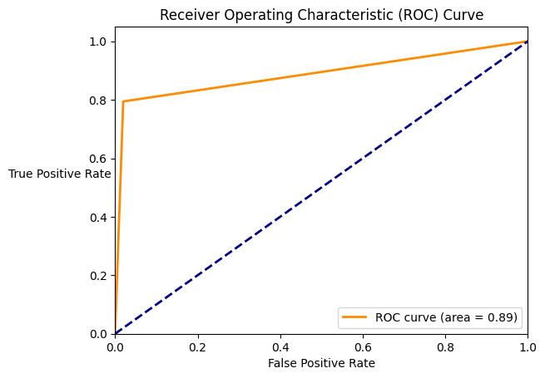
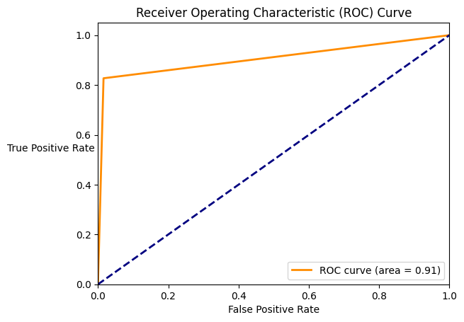
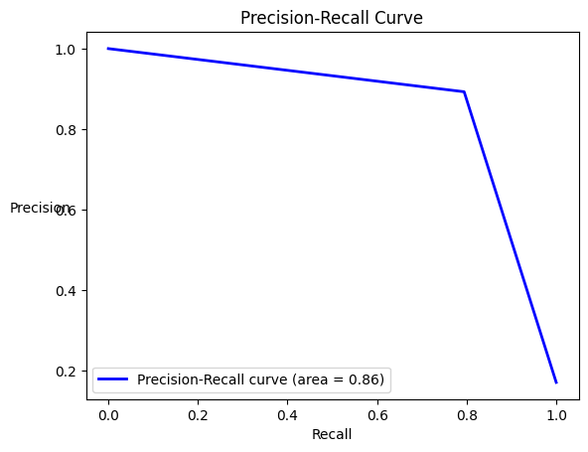
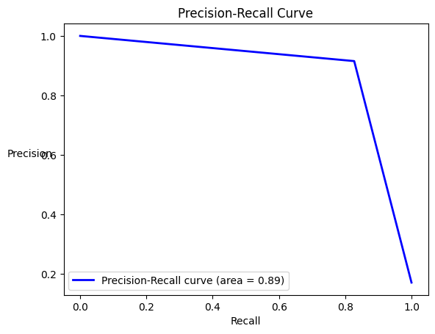

Slide 43
ABC: Artificial Bee Colony
Number of generations = 5
Number of generations = 100
Metric | Solution 1 | Solution 2
# features | 13 | 11
True Positive | 216214 | 220808
True Negative | 1404119 | 1382983
False Positive | 33045 | 54181
False Negative | 80723 | 76129
Accuracy | 0.934 | 0.925
Precision | 0.867 | 0.803
Recall | 0.728 | 0.744
F1-Score | 0.792 | 0.772
AUC score | 0.853 | 0.853
Balanced accuracy | 0.853 | 0.853
MCC | 0.757 | 0.728
NPV | 0.946 | 0.948
FDR | 0.133 | 0.197
Cohen Kappa | 0.753 | 0.727
Metric | Solution 1 | Solution 2
# features | 13 | 36
True Positive | 235888 | 245592
True Negative | 1408846 | 1414465
False Positive | 28318 | 22699
False Negative | 61049 | 51345
Accuracy | 0.948 | 0.957
Precision | 0.893 | 0.915
Recall | 0.794 | 0.827
F1-Score | 0.841 | 0.869
AUC score | 0.887 | 0.906
Balanced accuracy | 0.887 | 0.906
MCC | 0.812 | 0.845
NPV | 0.958 | 0.965
FDR | 0.107 | 0.085
Cohen Kappa | 0.81 | 0.844

Slide 44
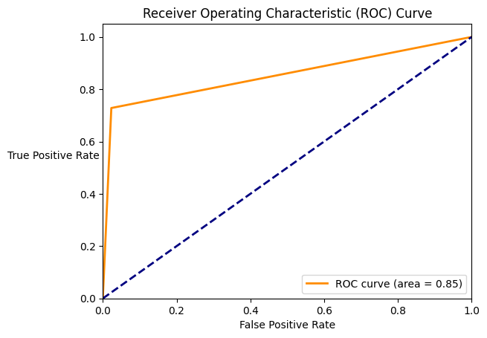
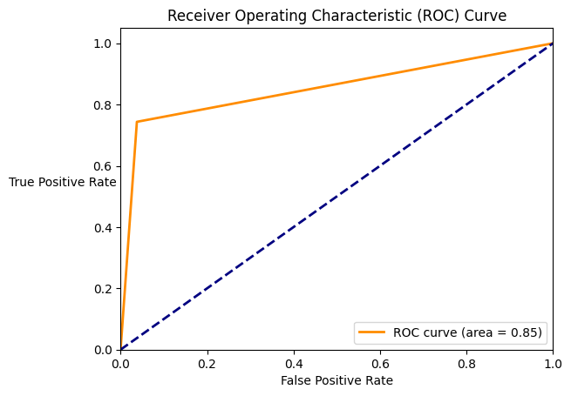
ABC: Artificial Bee Colony
Number of generations = 5
Number of generations = 100

Slide 45
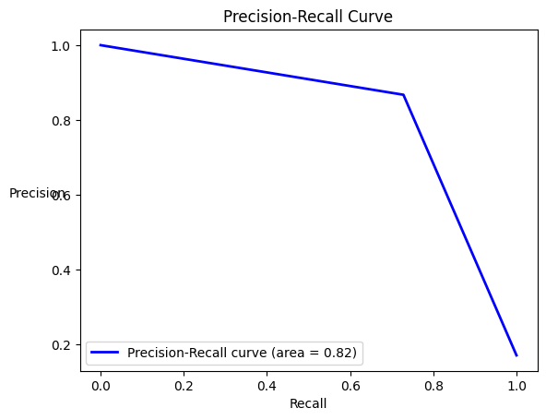
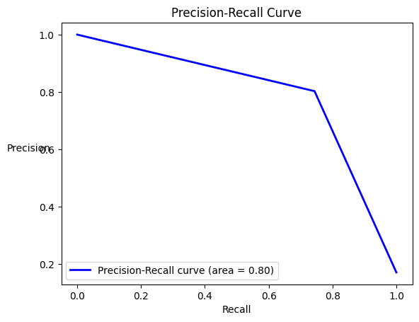
ABC: Artificial Bee Colony
Number of generations = 5
Number of generations = 100

Slide 46
FPA: Flower Pollination Algorithm
FPA | Solution 1 | Solution 2
# features | 20 | 22
True Positive | 240967 | 233642
True Negative | 1406688 | 1407695
False Positive | 30476 | 29469
False Negative | 55970 | 63295
Accuracy | 0.95 | 0.947
Precision | 0.888 | 0.888
Recall | 0.812 | 0.787
F1-Score | 0.848 | 0.834
AUC score | 0.895 | 0.883
Balanced accuracy | 0.895 | 0.883
MCC | 0.819 | 0.805
NPV | 0.962 | 0.957
FDR | 0.112 | 0.112
Cohen Kappa | 0.818 | 0.803

Slide 47


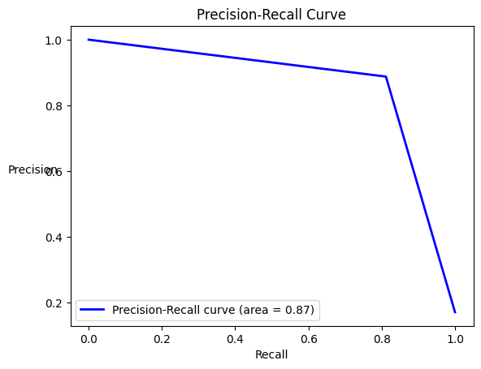
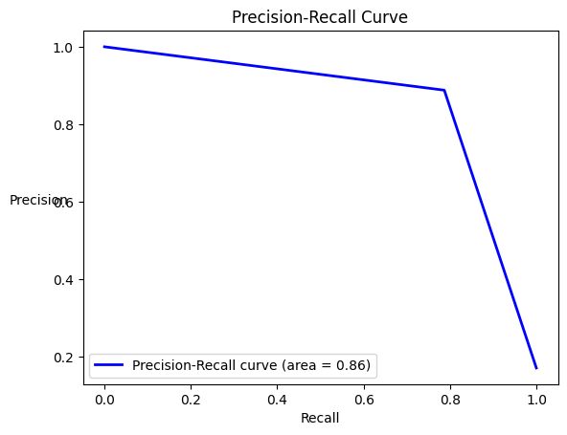

Slide 48
FPA: Flower Pollination Algorithm
Number of generations = 5
Number of generations = 100
Metric | Solution 1 | Solution 2
# features | 20 | 25
True Positive | 227649 | 236160
True Negative | 1401121 | 1400635
False Positive | 36043 | 36529
False Negative | 69288 | 60777
Accuracy | 0.939 | 0.944
Precision | 0.863 | 0.866
Recall | 0.767 | 0.795
F1-Score | 0.812 | 0.829
AUC score | 0.871 | 0.885
Balanced accuracy | 0.871 | 0.885
MCC | 0.778 | 0.797
NPV | 0.953 | 0.958
FDR | 0.137 | 0.134
Cohen Kappa | 0.776 | 0.796
Metric | Solution 1 | Solution 2
# features | 20 | 22
True Positive | 240967 | 233642
True Negative | 1406688 | 1407695
False Positive | 30476 | 29469
False Negative | 55970 | 63295
Accuracy | 0.95 | 0.947
Precision | 0.888 | 0.888
Recall | 0.812 | 0.787
F1-Score | 0.848 | 0.834
AUC score | 0.895 | 0.883
Balanced accuracy | 0.895 | 0.883
MCC | 0.819 | 0.805
NPV | 0.962 | 0.957
FDR | 0.112 | 0.112
Cohen Kappa | 0.818 | 0.803

Slide 49


FPA: Flower Pollination Algorithm
Number of generations = 5
Number of generations = 100

Slide 50
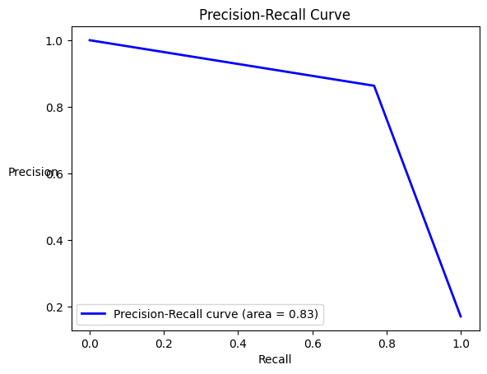

FPA: Flower Pollination Algorithm
Number of generations = 5
Number of generations = 100

Slide 51
ABC vs FPA after 100 generations
ABC algorithm | Solution 1 | Solution 2
# features | 13 | 36
True Positive | 235888 | 245592
True Negative | 1408846 | 1414465
False Positive | 28318 | 22699
False Negative | 61049 | 51345
Accuracy | 0.948 | 0.957
Precision | 0.893 | 0.915
Recall | 0.794 | 0.827
F1-Score | 0.841 | 0.869
AUC score | 0.887 | 0.906
Balanced accuracy | 0.887 | 0.906
MCC | 0.812 | 0.845
NPV | 0.958 | 0.965
FDR | 0.107 | 0.085
Cohen Kappa | 0.81 | 0.844
FPA | Solution 1 | Solution 2
# features | 20 | 22
True Positive | 240967 | 233642
True Negative | 1406688 | 1407695
False Positive | 30476 | 29469
False Negative | 55970 | 63295
Accuracy | 0.95 | 0.947
Precision | 0.888 | 0.888
Recall | 0.812 | 0.787
F1-Score | 0.848 | 0.834
AUC score | 0.895 | 0.883
Balanced accuracy | 0.895 | 0.883
MCC | 0.819 | 0.805
NPV | 0.962 | 0.957
FDR | 0.112 | 0.112
Cohen Kappa | 0.818 | 0.803

Slide 52
ABC vs FPA after 100 generations

Slide 53
ABC vs FPA after 100 generations

Slide 54
Comparison of results between ABC and FPA after 100 generations for Binary classifier
Metrics | ABC | FPA
Accuracy range | 0.948 - 0.957 | 0.947 - 0.950
Precision range | 0.893 - 0.915 | 0.888
Recall range | 0.794 - 0.827 | 0.787 - 0.812
F1-Score range | 0.841 - 0.869 | 0.834 - 0.848
AUC Score range | 0.887 - 0.906 | 0.883 - 0.895
MCC range | 0.812 - 0.845 | 0.805 - 0.819
NPV range | 0.958 - 0.965 | 0.957 - 0.962
FDR range | 0.085 - 0.107 | 0.112
Cohen Kappa range | 0.810 - 0.844 | 0.803 - 0.818

Slide 55
Summary of evaluation
Artificial Bee Colony: -
Perf.(Number of generations=100)>Perf.(Number of generations=5)
Flower Pollination Algorithm
Perf.(Number of generations=100)>Perf.(Number of generations=5)
Artificial Bee Colony vs Flower Pollination Algorithm (after 100 generations)
Artificial Bee Colony > Flower Pollination Algorithm

Slide 56
Thank you

Slide 57
Overview of papers in literature survey

Slide 58
An Adapted Ant Colony Optimization for Feature Selection
SVM classifier was used
Ant Colony Optimization used for feature selection.
Datasets used: -
Dataset name | # Features | # Class | # Instance
Wine | 13 | 3 | 178
Hepatitis | 19 | 2 | 155
WDBC | 30 | 2 | 569
Ionosphere | 34 | 2 | 351
Dermatology | 34 | 6 | 366
Spambase | 57 | 2 | 4601
Arrhythmie | 279 | 16 | 452
Madellon | 500 | 2 | 4400

Slide 59
Multi-Label Feature Selection Based on Improved Ant Colony Optimization Algorithm with Dynamic Redundancy and Label Dependence
Datasets used: -
Evaluation metrics
Dataset name | # Instances | # Features | # Labels
Scene | 2407 | 294 | 6
Enron | 1702 | 1001 | 53
Flags | 194 | 19 | 7
Emotions | 593 | 72 | 6
Chess | 1657 | 585 | 227
Image | 2000 | 284 | 5
Yeast | 2417 | 103 | 14
Hamming Loss
Average – Precision
One – error Loss
Micro – F1

Slide 60
Intrusion Detection in KDD99 Dataset using SVM – PSO and Feature Reduction with Information Gain
Particle Swarm Optimization was used to obtain best subset of features.
SVM classifier was used.
Dataset: KDD Cup 99
Evaluation metrics: -
Accuracy
Detection Rate
False Alarm

Slide 61
Evolving optimized decision rules for intrusion detection using Particle Swarm Paradigm
Particle Swarm Optimization was used for feature selection.
6 decision tree classifiers were used: -
Evaluation metrics: -
Detection percentage
Error percentage
False Positive
Precision
Recall
Decision Stump 4. Naïve Bayes Tree
C 4.5 5. Random Forest
Random Tree 6. Representative Tree Model

Slide 62
An Artificial Immune System for Classification with Local Feature Selection
3 classification algorithms were used: -
SVM
KNN
Datasets: -
Dataset name | Size | Features | Classes
Ionosphere | 351 | 34 | 2
Glass | 214 | 9 | 6
Breast Cancer | 699 | 9 | 2
Iris | 150 | 4 | 4
Wine | 178 | 13 | 3
Diabetes | 768 | 8 | 2
Heart Statlog | 270 | 13 | 2
Sonar | 208 | 60 | 2
Cleveland | 303 | 13 | 2

Slide 63
Artificial Bee Colony Optimization for Feature Selection in Opinion Mining
Artificial Bee Colony algorithm was used for feature selection.
3 machine learning algorithms were used: -
Naïve Bayes
Fuzzy Unordered Rule Induction Algorithm
Ripple Down Rule Learners
Dataset: - Internet movie database
Evaluation metrics: -
Classification accuracy
RMSE
Precision
Recall

Slide 64
Data feature selection based on Artificial Bee Colony algorithm
Artificial Bee Colony algorithm was used for feature selection.
Evaluation metrics: Accuracy
Datasets
Dataset name | # Instances | # Features | # Classes
Image segmentation | 2310 | 19 | 7
Auto | 205 | 25 | 7
Breast Cancer | 286 | 9 | 2
Diabetes | 786 | 8 | 2
Glass | 214 | 9 | 7
Heart – C | 303 | 13 | 5
Heart Statlog | 270 | 13 | 2
Hepatic | 155 | 19 | 2
Iris | 150 | 4 | 2
Labor | 57 | 16 | 2

Slide 65
A Two-Stage Feature Selection Approach Based on Artificial Bee Colony and Adaptive LASSO in High-Dimensional data
Number of generations = 300
4 datasets were used: -
Communities and crime dataset
Large scale wave energy farm dataset
Insurance company benchmark dataset
Federal reserve economic dataset
3 evaluation metrics were used: -
Accuracy
Specificity
Sensitivity

Slide 66
Artificial Bee Colony Approach for Optimizing Feature Selection
Artificial Bee Colony algorithm was used for feature selection.
Evaluation metric: Accuracy
Datasets: -
Dataset name | # Instances | # Features | # Classes
Heart – C | 303 | 14 | 2
Dermatology | 366 | 34 | 6
Hepatitis | 155 | 19 | 2
Lung Cancer | 32 | 56 | 2
Pima Indian Diabetes | 768 | 8 | 2
Iris | 150 | 4 | 3
Wisconsin | 699 | 9 | 2
Lymphograhy | 148 | 18 | 4

Slide 67
Binary Flower Pollination Algorithm and its Application to Feature Selection
Flower Pollination algorithm was used for feature selection.
Machine Learning algorithm: Optimum Path Forest.
Fitness function: Accuracy
Datasets: -
Dataset name | # Samples | # Features | # Classes
GLI-85 | 85 | 22283 | 2
SMKCAN 187 | 187 | 19993 | 2
TOX 171 | 171 | 5748 | 4
AR 10P | 130 | 2400 | 10
NTL | 4952 | 8 | 2

Slide 68
A Binary Clonal Flower Pollination for Feature Selection
Flower Pollination Algorithm was used for feature selection.
Evaluation metric: Accuracy
Dataset: -
Dataset name | # Samples | # Samples per class | # Features | # Classes
Australian | 690 | Class 1 = 307 Class 2 = 383 | 14 | 2
Breast Cancer | 699 | Class 1 = 458 Class 2 = 241 | 10 | 2
German number | 1000 | Class 1 = 7000 Class 2 = 3000 | 24 | 2

Slide 69
Flower pollination algorithm: A novel approach for multi objective optimization
Extend Flower Pollination Algorithm from single objective optimization to multi-objective optimization.
Use of structural design methods for optimization: -
Welded Beam design
Disc break design

Slide 70
Examples to illustrate computation of values for Evaluation metrics

Slide 71
Accuracy
Accuracy= TP+TN/TP+TN+FP+FN
Accuracy=(1400635+236160)
/(1400635+236160+36529+60777)
= 0.944

Slide 72
Precision
Precision= TP/TP+FP
Precision= 236160/(236160+36529)
= 0.866

Slide 73
Recall
Recall= TP/TP+FN
Recall= 236160/(236160+60777)
= 0.795

Slide 74
F1-Score
F1-Score= 2*(Precision*Recall)
/(Precision+Recall)
= 2*(0.866*0.795)/(0.866+0.795)
= 0.829

Slide 75
Balanced accuracy
Balanced accuracy = (Sensitivity + Specificity)/2
Sensitivity = TP/(TP+FN) = True Positive Rate
Specificity = TN/(TN+FP) = True Negative Rate
Sensitivity = 236160/(236160+60777) = 0.795
Specificity = 1400635/(1400635+36529) = 0.974
Balanced accuracy = (0.795+0.974)/2
= 0.885

Slide 76
Matthews Correlation Coefficient (MCC)
MCC = [(TN*TP)-(FP*FN)]/sqrt([TP+FN]*[FP+TP]*[TN+FP]*[FN+TP])
= 0.797

Slide 77
Negative Predictive Value (NPV)
NPV = TN/TN+FN
= 1400635/(1400635+60777)
= 0.958

Slide 78
False Discovery Rate (FDR)
FDR = 1 - PPV
PPV = TP/(TP+FP)
PPV = 236160/(236160+36529) = 0.866
FDR = 1- 0.866 = 0.134

Slide 79
Cohen Kappa metric
Actual = Malicious -> FN+TP = 60777+236160
= 296937 = 17%
Actual = Benign -> TN+ FP = 1400635+36529
= 1437164 = 83%
Predicted = Malicious -> TP+FP = 236160+36529 = 272689 = 16%
Predicted = Benign -> TN+FN = 1400635+60777 = 1461412 = 84%
P(Actual and Predicted) = 0.17*0.16 = 0.0272
P(Actual’ and Predicted’) = 0.83*0.84 = 0.6972
Pe=0.0272+0.6972=0.7244
Po=Accuracy = 0.944
k=(0.944-0.7244)/(1-0.7244) = 0.796

